Slide 1
Lecture Notes: The Point Processing of Images

Slide 2
Point Processing of Images
In a digital image, a point = a pixel.
Point processing transforms a pixel’s value as function of its value alone.
It does not depend on the values of the pixel’s neighbors.

Slide 3
Point Processing of Images
Examples include:
Brightness and contrast adjustment
Gamma correction
Histogram equalization
Histogram matching
Color correction.

Slide 4
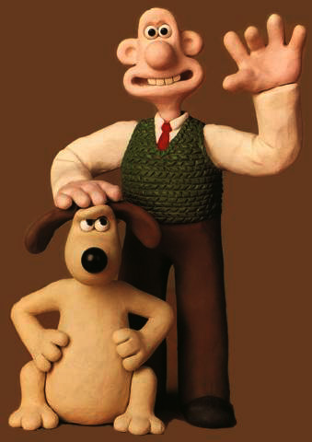
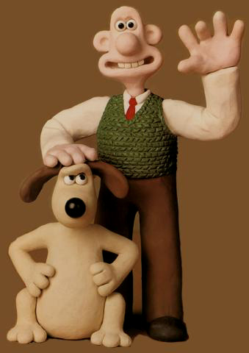
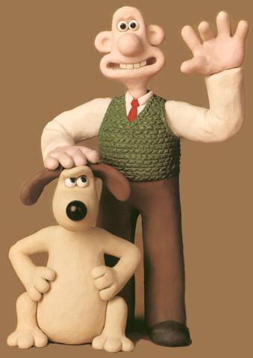
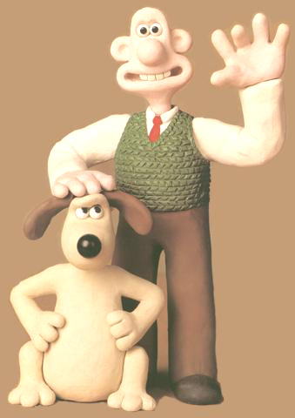
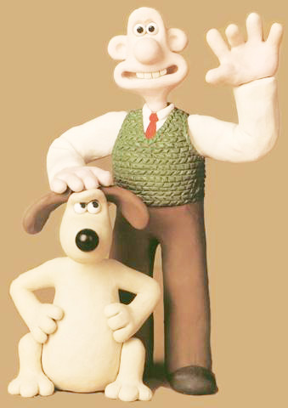
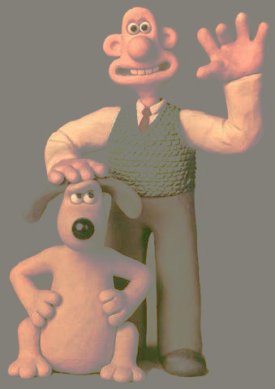
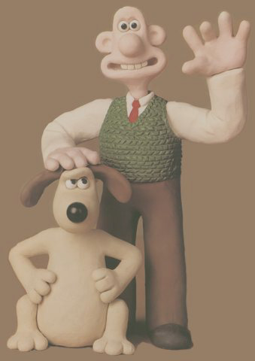
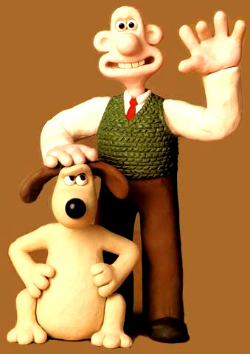
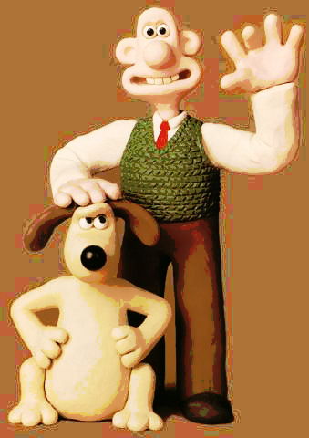
Point Processing
- gamma
- brightness
original
+ brightness
+ gamma
histogram mod
- contrast
original
+ contrast
histogram EQ

Slide 5
Point Processing: Pixel Values
A point process transforms one intensity level (or color) into another as a function of that one alone. So a point process is
That is, the pixel value output is dependent on only the pixel value input. That implies
In words, the output at one location is dependent only the value of the input image at that same location. Other locations don’t matter.

Slide 6
Point Ops via Functional Mappings
Image:
I
Φ, point operator
J
Input
Output
Pixel:
I(r, c)
function, f
J(r, c)
The transformation of image I into image J is accomplished by replacing each input intensity, g, with a specific output intensity, k, at every location (r,c,b) where I(r,c,b) = g.
The rule that associates k with g is usually specified with a function, f, so that f (g) = k.

Slide 7
Point Ops via Functional Mappings
One-band Image
J(r, c) = f ( I(r, c) ),
for all pixel locations, (r,c).
Three-band Image
J(r, c, b) = f ( I(r, c, b) ), or
J(r, c, b) = f_{b} ( I(r, c, b) ), or
for b = 1, 2, 3, and all (r, c).

Slide 8
Point Ops via Functional Mappings
One-band Image
J(r, c) = f ( I(r, c) ),
for all pixel locations, (r,c).
Either all 3 bands are mapped through the same function, f, or …
Three-band Image
J(r, c, b) = f ( I(r, c, b) ), or
J(r, c, b) = f_{b} ( I(r, c, b) ), or
for b = 1, 2, 3, and all (r, c).
… each band is mapped through a separate func-tion, f_{b}.

Slide 9
Look-Up Tables

Slide 10
Lookup Tables
A lookup table is an indexed list of numbers – a vector – that can be used to implement a discrete function – a mapping from a set of integers, {g_{in,1}, g_{in,2}, ... , g_{in,n}}, to a set of numbers (integers or not), {g_{out,1}, g_{out,2}, ... , g_{out,n}}. A lookup table can implement a function such as:
We’ve already seen one of these, the colormap.¹
¹ Lecture 2, slides 29-40.

Slide 11
Point Operations using Lookup Tables
… then the LUT that implements f is a 256x1 array
whose (g +1)^{th} value is k = f (g).
A lookup table (LUT) can implement a functional mapping.
LUT is 256x1. But I may be RxC or RxCx3.
To remap an image, I, to J :
J = LUT(I+1)

Slide 12
Point Operations = Lookup Table Ops
255
E.g.:
index
value
...
101
102
103
104
105
106
...
...
64
68
69
70
70
71
...
127
output value
0
0
127
255
input value
input
output

Slide 13
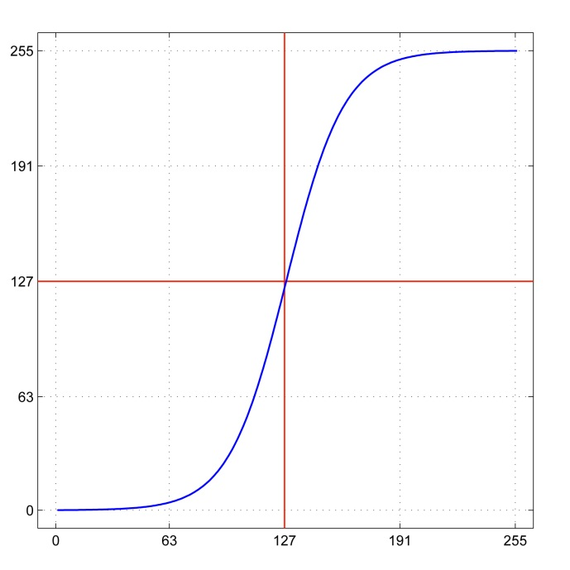
How to Generate a Lookup Table
For example, a sigmoid:
Or in Matlab:
a = 2;
x = 0:255;
LUT = 255 ./ (1+exp(-a*(x-127)/32));
This is just one example.

Slide 14
Point Ops on RGB Images using Lookup Tables
If I is 3-band, then
each band is mapped separately using the same LUT for each band or
each band is mapped using different LUTs – one for each band.
a) J = LUT(I+1),
b) J(:,:,b) = LUT_{b}(I(:,:,b) +1), for b = 1, 2, 3.

Slide 15
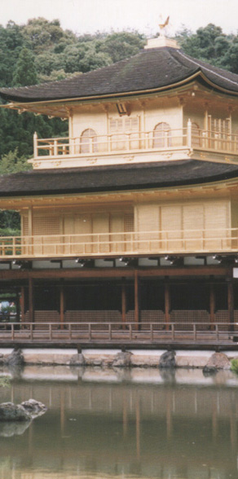
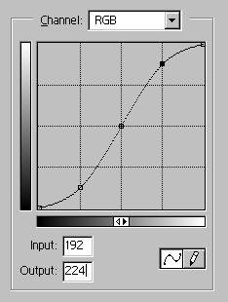
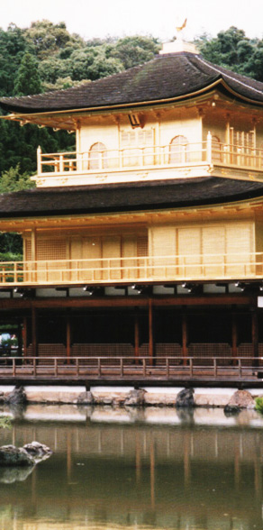
1-Band Lookup Table for 3-Band Image
input
output
.
.
.
.
.
.
.
.
a pixel with this value
.
.
is mapped to this value
.
.
cell index
contents
.
.
.
.
.
.
.
.
.
.
.
.

Slide 16
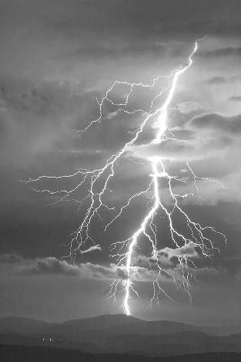
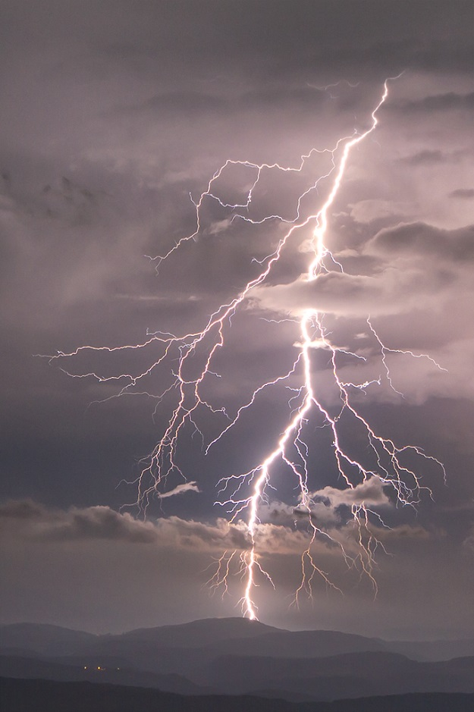

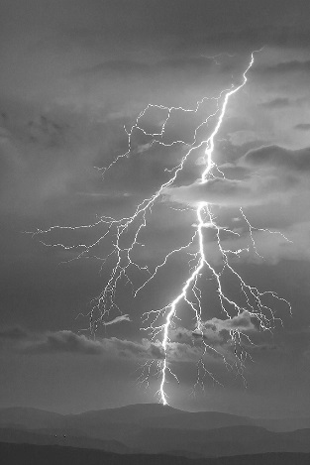
Example 3-Band Image …
R
G
R, G, B Bands
B
Lightning at Ramasse, Rhone-Alpes, France by Flickr user, Regarde là-bas, https://www.flickr.com/photos/marcel_s_s/8624344496/in/pool-tbasab/

Slide 17
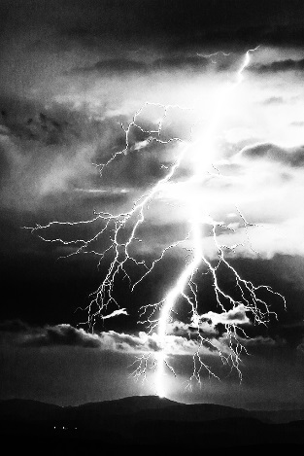
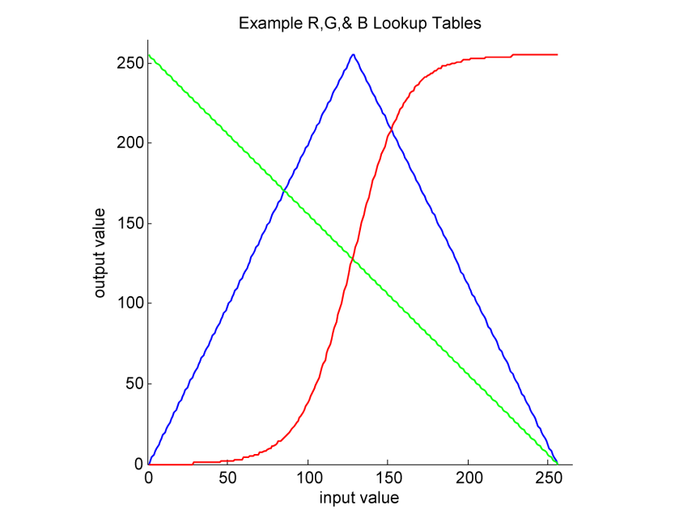
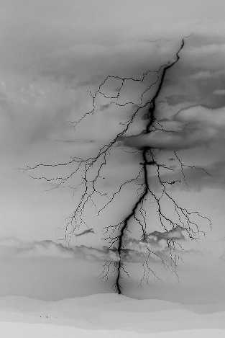
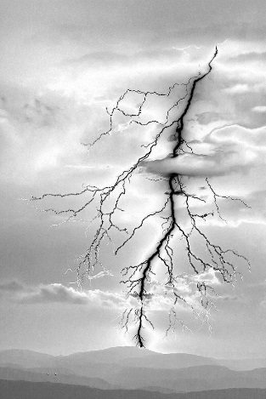
… with 3-Band LUT.
R
G
B
Lightning at Ramasse, Rhone-Alpes, France by Flickr user, Regarde là-bas, https://www.flickr.com/photos/marcel_s_s/8624344496/in/pool-tbasab/

Slide 18
… with 3-Band LUT.
R is mapped through a sigmoid.
R
G is mapped to its negative
G
The dark values of B are contrast stretched while the light values are negated and stretched.
B
Lightning at Ramasse, Rhone-Alpes, France by Flickr user, Regarde là-bas, https://www.flickr.com/photos/marcel_s_s/8624344496/in/pool-tbasab/

Slide 19
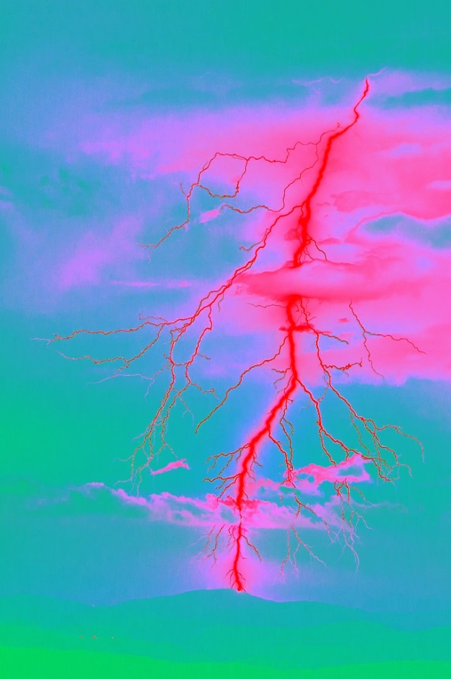
3-Band Image with 3-Band LUT.
Resultant bands recom-bined into one image.
Lightning at Ramasse, Rhone-Alpes, France by Flickr user, Regarde là-bas, https://www.flickr.com/photos/marcel_s_s/8624344496/in/pool-tbasab/

Slide 20
3-Band Image with 3-Band LUT.
A silly example to demon-strate some possibilities.
Lightning at Ramasse, Rhone-Alpes, France by Flickr user, Regarde là-bas, https://www.flickr.com/photos/marcel_s_s/8624344496/in/pool-tbasab/

Slide 21
Basic Point Processing: Brightness, Contrast, and Gamma

Slide 22
Point Processing
- gamma
- brightness
original
+ brightness
+ gamma
histogram mod
- contrast
original
+ contrast
histogram EQ

Slide 23
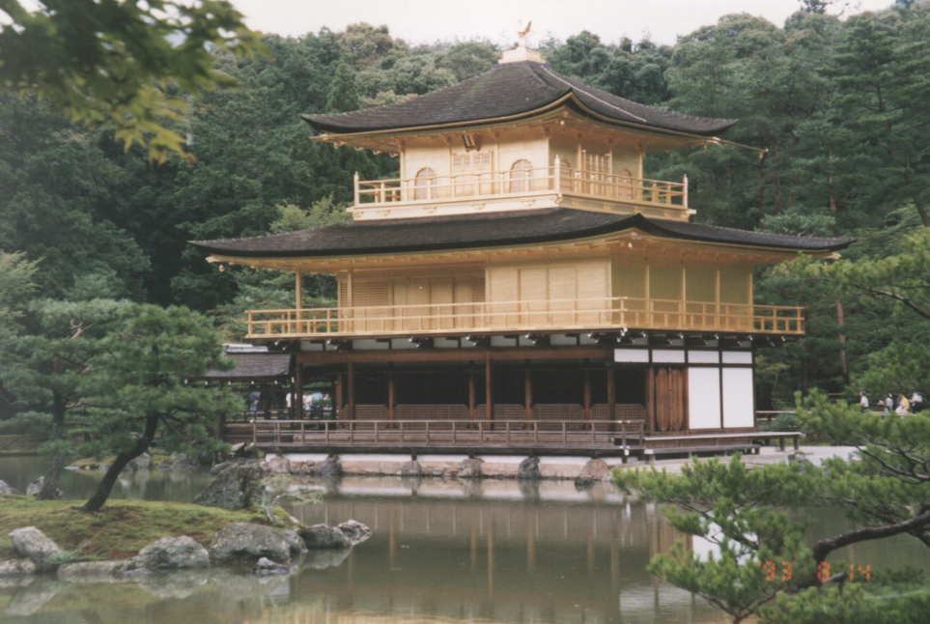
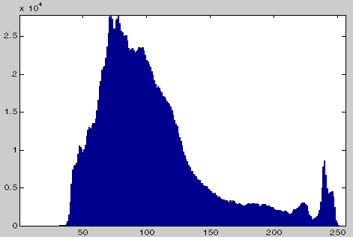
Point Processes: Original Image
Kinkaku-ji (金閣寺, Temple of the Golden Pavilion), also known as Rokuon-ji (鹿苑寺, Deer Garden Temple), is a Zen Buddhist temple in Kyoto, Japan.
Photo by Alan Peters, August 1993.
Luminance Histogram
For more information on this fascinating, unique place read the historical novel by Mishima,Yukio, The Temple of the Golden Pavilion, translated by Ivan Morris, Shinchosha Publishing Co, Ltd., 1956.

Slide 24
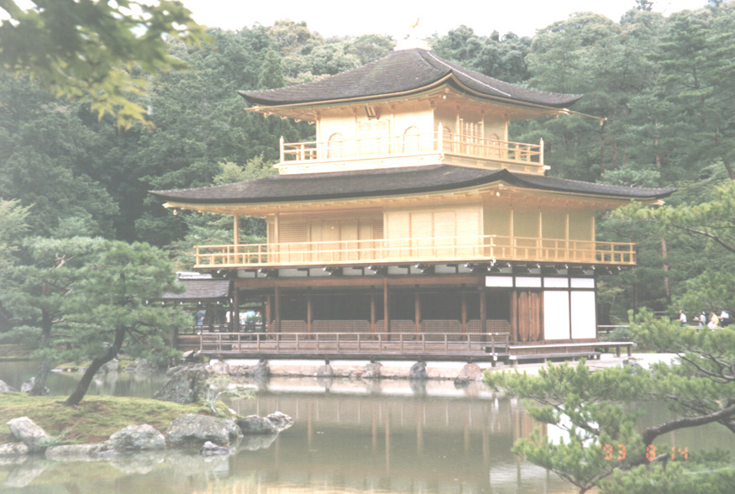
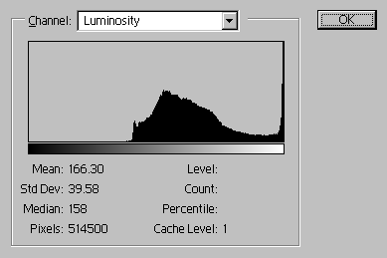
Point Processes: Increase Brightness
255
127
saturation point
0
0
127
255
LUT Mapping

Slide 25
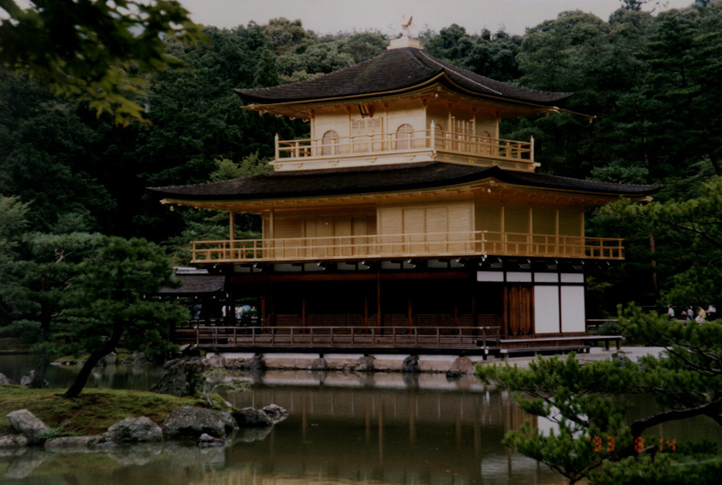
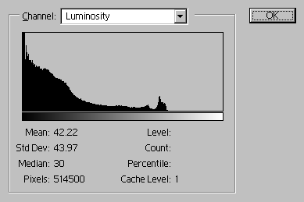
Point Processes: Decrease Brightness
255
zero point
255-g
127
0
0
127
255
LUT Mapping

Slide 26
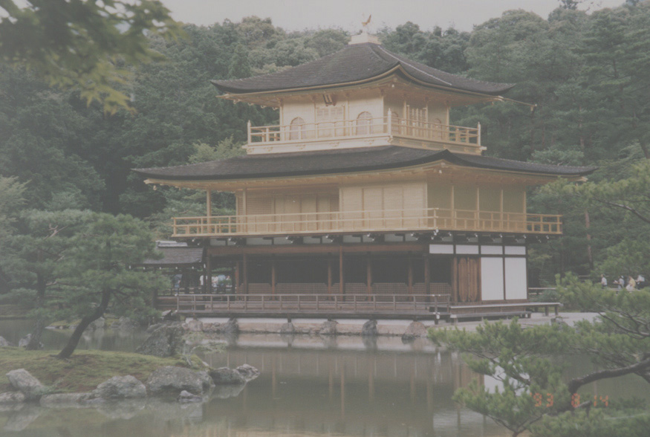
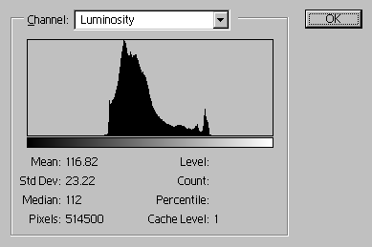
Point Processes: Decrease Contrast
255
Here, s = 127
127
s is the center of the contrast function.
0
0
127
255
LUT Mapping

Slide 27
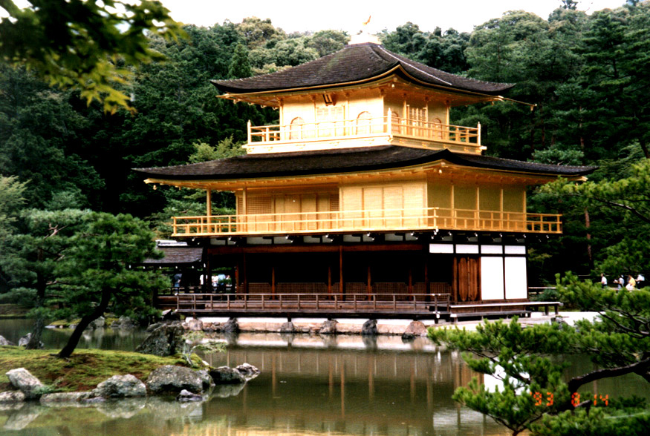
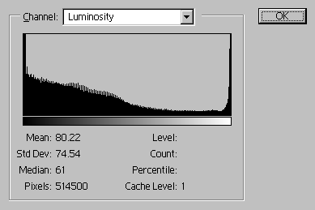
Point Processes: Increase Contrast
255
zero point
Here, s = 127
127
0
sat. point
0
127
255
LUT Mapping

Slide 28
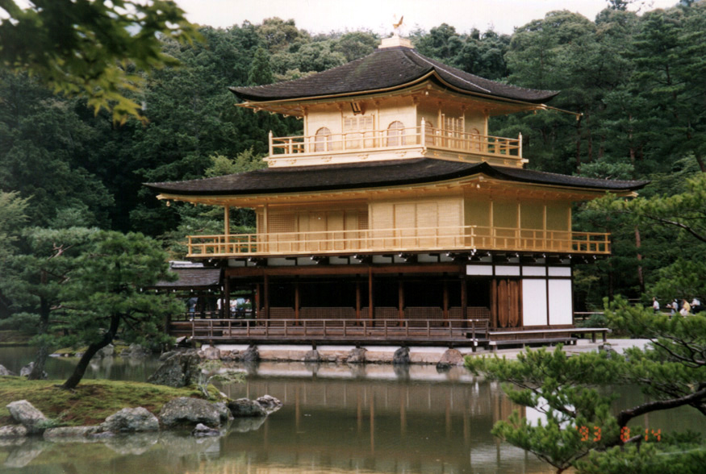
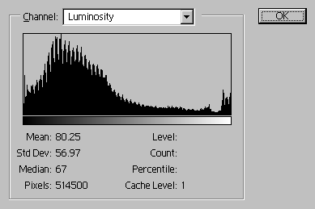
Point Processes: Contrast Stretch
M_{J}
255
zero point
127
center point
m_{J}
0
sat. point
0
m_{I}
127
M_{I}
255
LUT Mapping

Slide 29

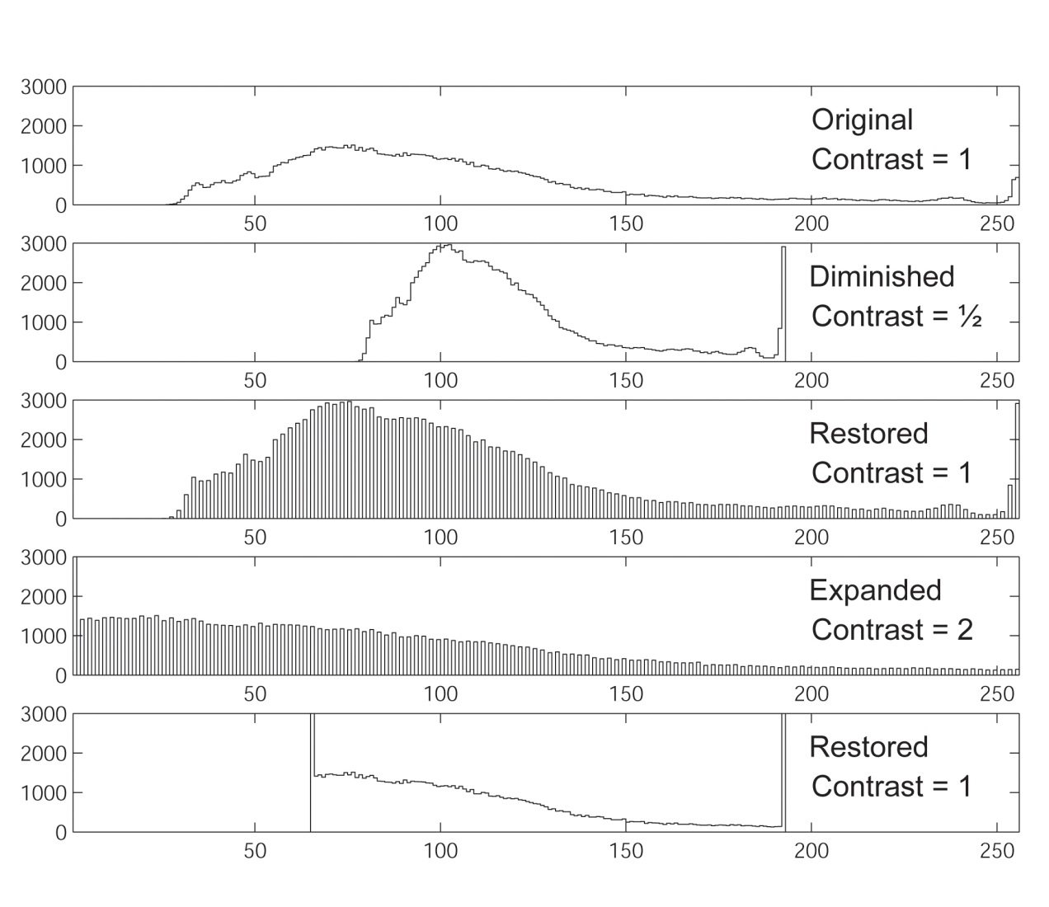

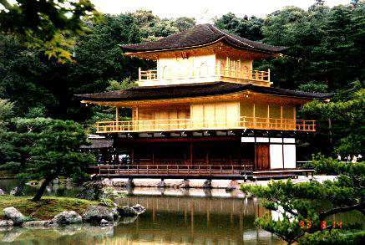
Information Loss from Contrast Adjustment
histograms
orig
lo-c
hi-c

Slide 30

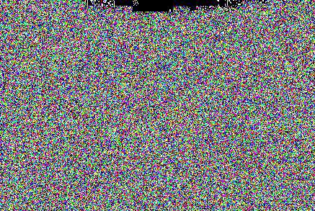
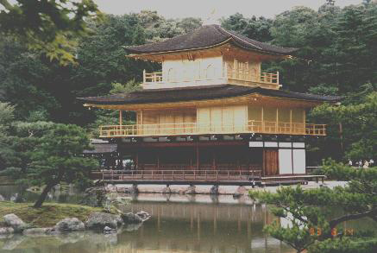
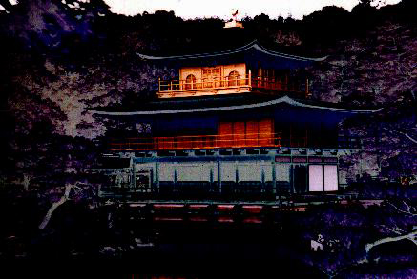
Information Loss from Contrast Adjustment
orig
lo-c
hi-c
abbreviations:
original
low-contrast
high-contrast
restored
difference
orig
lo-c
lo-c
difference between original and restored low-contrast
rest
diff
orig
hi-c
hi-c
difference between original and restored high-contrast
rest
diff

Slide 31

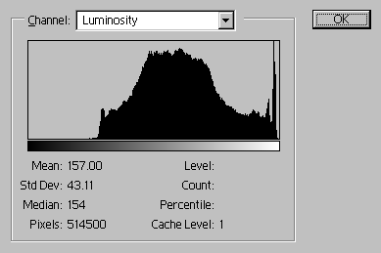
Point Processes: Increased Gamma
255
127
0
0
127
255
LUT mapping

Slide 32
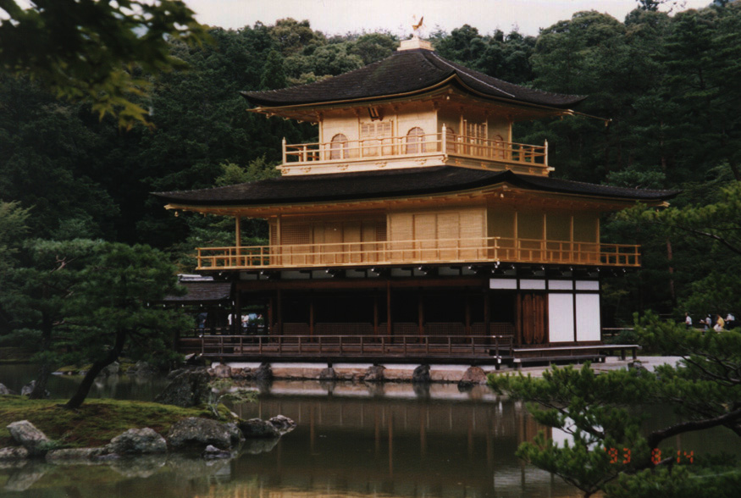
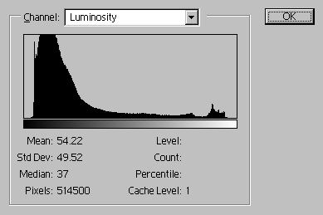
Point Processes: Decreased Gamma
255
127
0
0
m
127
M
255
LUT mapping

Slide 33
Point Processes: Decreased Gamma
Rather than rather than 255[I/255]^{1/γ}, gamma correction can also be defined as 255[I/255]^{γ}. The effects are opposite. That definition is often used for image processing as a precursor to coding for transmission. (https://en.wikipedia.org/wiki/Gamma_correction.)
255
127
0
0
m
127
M
255
LUT mapping

Slide 34
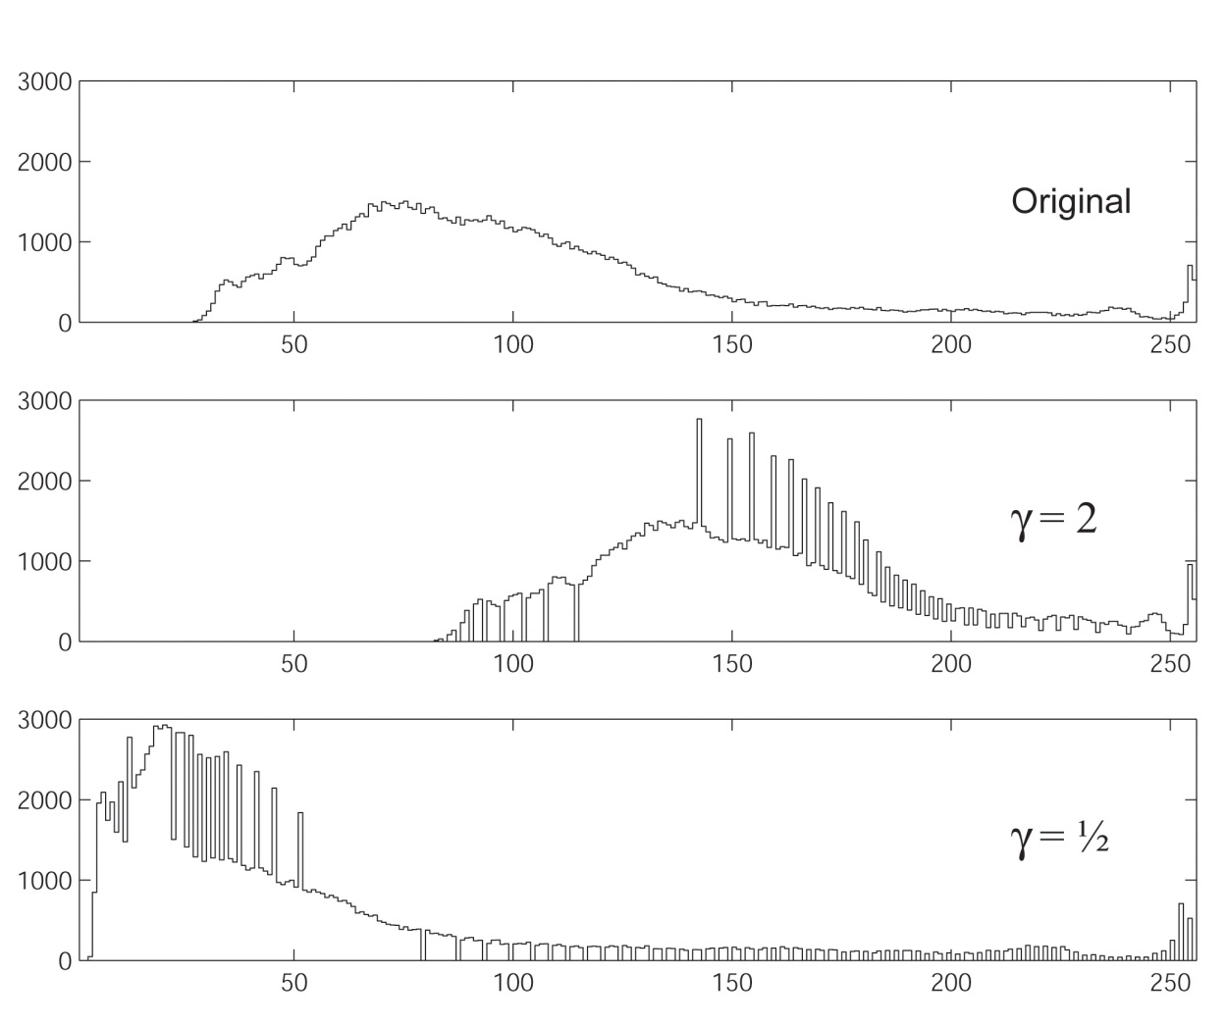
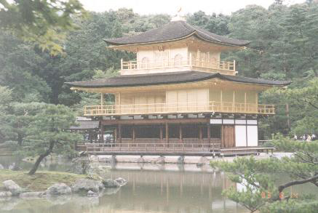
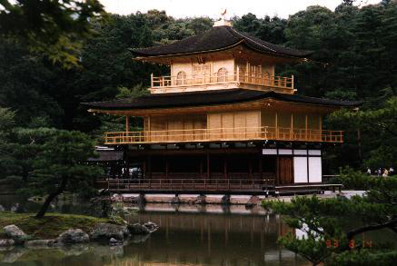
Gamma Correction: Effect on Histogram

Slide 35
Point Processing: Histogram Equalization

Slide 36
Point Processes: Histogram Equalization
Task: remap a 1-band image I so that its histogram is as close to constant as possible. This maximizes the contrast evenly across the entire intensity range.
be the cumulative (probability) distribution
function of I. Then J has, as closely as possible, a flat (constant) histogram if:
one-band image
The scaled CDF itself is used as the LUT.
That is, to equalize a one-band image, map it through its own CDF multiplied by the maximum desired output value.

Slide 37
Point Processes: Histogram Equalization
Task: remap image I with min = m_{I} and max = M_{I} so that its histogram is as close to constant as possible and has min = m_{J} and max = M_{J} .
be the cumulative (probability) distribution function of I.
Then J has, as closely as possible, the correct histogram if
Using intensity extrema

Slide 38
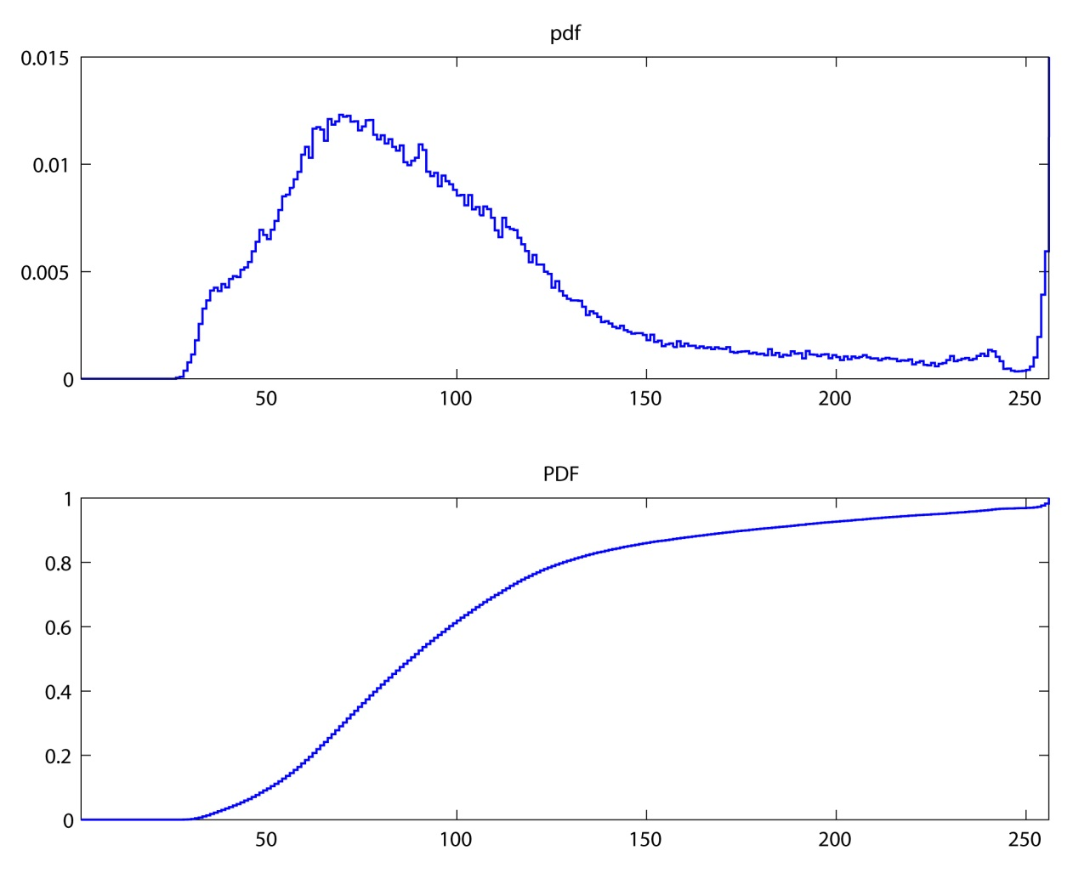
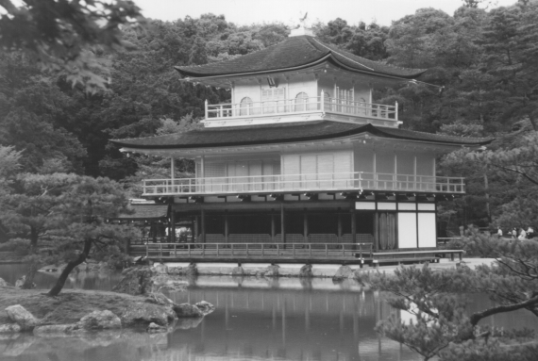
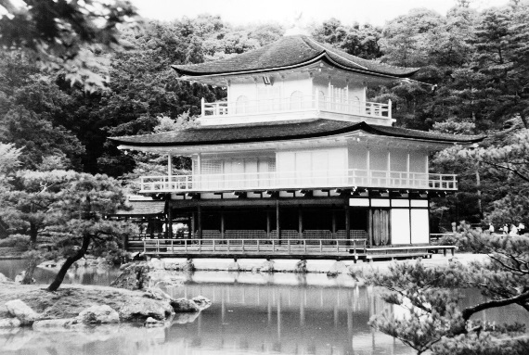
Histogram EQ
The CDF (cumulative distribution) × 255 is the LUT for remapping.
pdf
Value Image
CDF
Histogram EQ’d Value Image

Slide 39
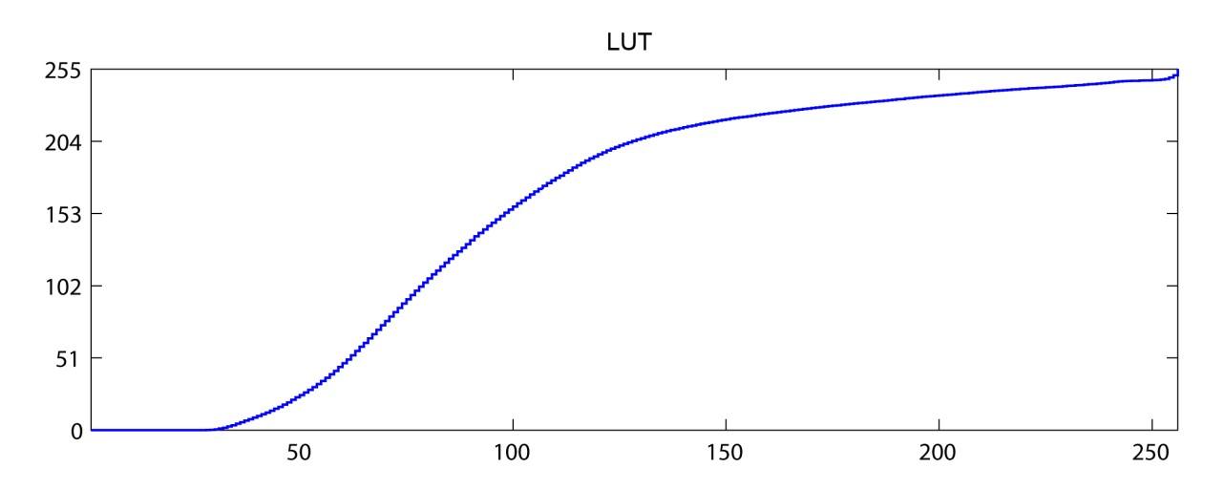
Histogram EQ
The CDF (cumulative distribution) × 255 is the LUT for remapping.
pdf
Value Image
LUT
Histogram EQ’d Value Image

Slide 40
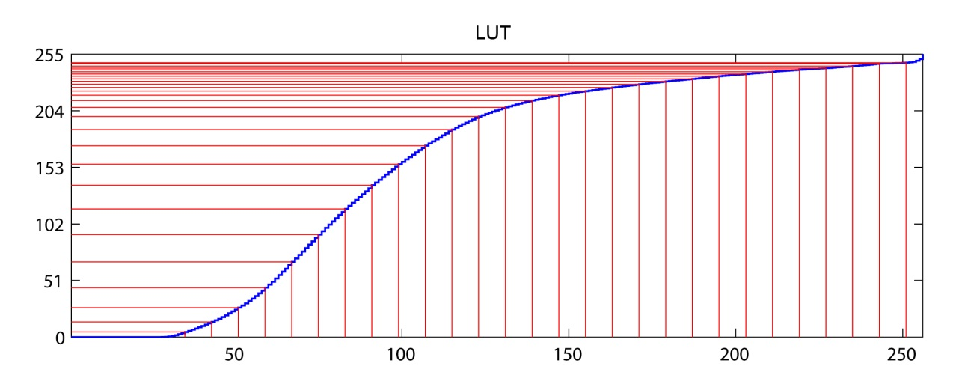
Histogram EQ
The CDF (cumulative distribution) × 255 is the LUT for remapping.
pdf
Value Image
LUT
Histogram EQ’d Value Image

Slide 41
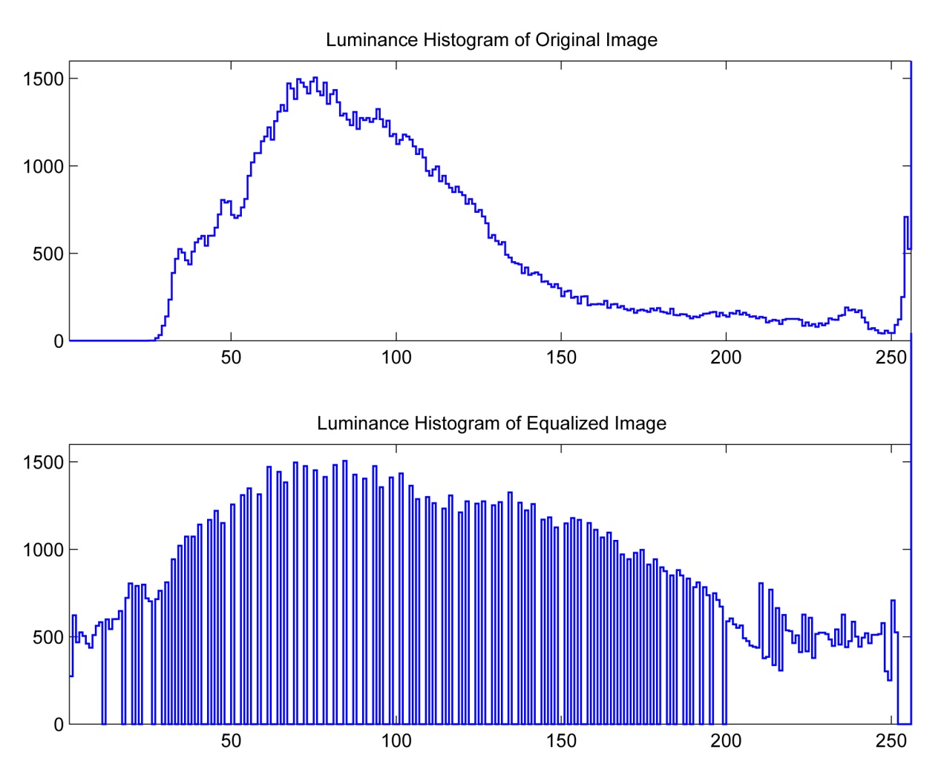
Histogram EQ
Value Image
Histogram EQ’d Value Image

Slide 42


Histogram EQ of a Grayscale Image
Once again, but bigger (and with more feeling!)
Luminance Image
Luminance Histogram

Slide 43

Histogram EQ of a Grayscale Image
Once again, but bigger (and with more feeling!)
Luminance Image
Luminance CDF

Slide 44

Histogram EQ of a Grayscale Image
Once again, but bigger (and with more feeling!)
Luminance Image
Equalization LUT

Slide 45


Histogram EQ of a Grayscale Image
Once again, but bigger (and with more feeling!)
Equalized Luminance Image
Histogram of Eq’d Image

Slide 46
Histogram EQ of a Grayscale Image
Once again, but bigger (and with more feeling!)
Luminance Image
Equalized Luminance Image
Note the detail loss in saturated areas.

Slide 47


Histogram EQ of Individual Color Bands
One CDF-based LUT for each band
Original Color Image
Color Histograms
Here we will create a separate equalization LUT for each of the color bands from each of their CDFs.

Slide 48

Histogram EQ of Individual Color Bands
One CDF-based LUT for each band
Original Color Image
Color CDFs
Here we will create a separate equalization LUT for each of the color bands from each of their CDFs.

Slide 49

Histogram EQ of Individual Color Bands
One CDF-based LUT for each band
Original Color Image
Equalization LUTs
These are the separate equalization LUTs – one for each of the color bands.

Slide 50


Histogram EQ of Individual Color Bands
One CDF-based LUT for each band
Equalized Color Image
Histogram of Eq’d Image
This is the result of mapping each band through its own equalization LUT. Notice how the hues have changed in some parts of the image.

Slide 51
Histogram EQ of Individual Color Bands
One CDF-based LUT for each band
Original Color Image
Equalized Color Image
This is the result of mapping each band through its own equalization LUT. Notice how the hues have changed in some parts of the image.

Slide 52
Histogram EQ of Individual Color Bands
One CDF-based LUT for each band
Equalized Color Image
Original Color Image
This is the result of mapping each band through its own equalization LUT. Notice how the hues have changed in some parts of the image.

Slide 53
Luminance EQ of a Color Image
Original Color Image
Color Histograms
Here we compute the CDF of the luminance or value image, make a LUT from it, then remap all three color bands through the same LUT.

Slide 54
Luminance EQ of a Color Image
Luminance Image
Luminance Histogram
Here we compute the CDF of the luminance or value image, make a LUT from it, then remap all three color bands through the same LUT.

Slide 55
Luminance EQ of a Color Image
Original Color Image
Color CDFs
Here we compute the CDF of the luminance or value image, make a LUT from it, then remap all three color bands through the same LUT.

Slide 56
Luminance EQ of a Color Image
Luminance Image
Luminance CDF
Here we compute the CDF of the luminance or value image, make a LUT from it, then remap all three color bands through the same LUT.

Slide 57
Luminance EQ of a Color Image
Original Color Image
Equalization LUT
Here we compute the CDF of the luminance or value image, make a LUT from it, then remap all three color bands through the same LUT.

Slide 58

Luminance EQ of a Color Image
Luminance Eq’d Color Image
Original Color Image
This is what we get when we map each of the three bands through the LUT created from the CDF of the image’s luminance.

Slide 59
Histogram EQ of the Individual Bands
Each band EQ’d Separately
Luminance EQ’d Color Image
The left image is what we got when we equalized each of the three bands separately. The right image is what we get when we map each color band through the luminance CDF

Slide 60
Luminance EQ of a Color Image
Original Color Image
Luminance Eq’d Color Image
Remapping each of the color bands through the luminance CDF LUT preserves the hues of the original image better than the individual equalization of each color band.

Slide 61
Point Processing: Histogram Matching

Slide 62
Point Processing: Histogram Matching
Task: Remap image I_{d} (discolored) so that it has, as closely as possible, the same histogram as image J_{r} (reference).
Q: Why do this?
A: Restore a degraded image based on an original.
Match the characteristics of images of the same
scene from different cameras.

Slide 63
Point Processing: Histogram Matching
Task: Remap image I_{d} (discolored) so that it has, as closely as possible, the same histogram as image J_{r} (reference).
Because the images are digital it is not, in general, possible to make h_{d} ≡ h_{r} . Therefore, p_{d} ≡ p_{r} .
Q: How, then, can the matching be done?
A: By matching percentiles.

Slide 64
Matching Percentiles
d: discolored
r: reference
… assuming a 1-band image, one band of a color image, or its luminance image.
Recall:
CDF P_{d} of image I_{d} is such that 0 ≤ P_{d} ( g_{d} ) ≤ 1.
P_{d} ( g_{d} +1) = c means that c is the fraction of pixels in I_{d} that have a value less than or equal to g_{d} .
100c is the percentile of pixels in I_{d} that are less than or equal to g_{d} .
To match percentiles, replace all occurrences of value g_{d} in image I_{d} with value g_{r} from image J_{r} whose percentile in J_{r} most closely matches the percentile of g_{d} in image I_{d}.

Slide 65


Matching Percentiles
d: discolored
r: reference
… assuming a 1-band image, one band of a color image or its luminance image.
So, to create an image, K, from image I_{d} such that K has nearly the same CDF as image J_{r} do the following:
Example:
I_{d}(r,c) = 5
P_{d} (5) = 0.65
P_{r} (9) = 0.56
P_{r} (10) = 0.67
K(r,c) = 10
If I_{d}(r,c) = g_{d} then let K(r,c) = g_{r} where g_{r} is such that
P_{d} (g_{d}) > P_{r} (g_{r} -1) AND P_{d} (g_{d}) ≤ P_{r} (g_{r}).
P_{d} ( g_{d} )
P_{r} ( g_{r} )
g_{I}
g_{J}

Slide 66
Histogram Matching Algorithm
d: discolored
r: reference
… assuming a 1-band image, one band of a color image or its luminance image.
[R,C] = size(I_{d});
K = zeros(R,C);
g_{r} = m_{r;}
This directly matches image I_{d} to image J_{r}.
for g_{d} = m_{d} to M_{d}
while
end
Better to use a LUT. See slide 74.
end

Slide 67


Example: Histogram Matching
Discolored Image pdf
Discolored Image with
16 intensity
values.
g

Slide 68

Discolored Image CDF
Example: Histogram Matching
CDF_{I}(g)
*
g
*a.k.a Cumulative Distribution Function, CDF_{I}.

Slide 69


Example: Histogram Matching
Reference Image pdf
Reference image with
16 intensity
values.
Target a.k.a. Reference
g

Slide 70

Reference Image CDF
Example: Histogram Matching
CDF_{I}(g)
*
Target a.k.a. Reference
g
*a.k.a Cumulative Distribution Function, CDF_{J}.

Slide 71
Histogram Matching with a Lookup Table
The algorithm on slide 66 matches one image to another directly. Often it is faster or more versatile to use a lookup table (LUT). Rather than remapping each pixel in the image separately, one can create a table that indicates to which target value each input value should be mapped. Then
K = LUT[I_{d} + 1]
In Matlab if the LUT is a 256 × 1 matrix with values from 0 to 255 and if image I_{d} is one-band of type uint8, it can be remapped with the following code:
K = uint8(LUT(I+1));

Slide 72
Histogram Matching with a Lookup Table
The E-Z teenage New York version* on the previous page only works for one-band images. For truecolor or other multiband images you need to execute the LUT on each band separately. Viz:
if E == 1 % single band LUT; multi-band image
for b = 1:B
J(:,:,b) = LUT(1+double(I(:,:,b)));
end
else % multiband LUT; multi-band image
for b = 1:B
LUT1D = squeeze(LUT(:,1,b));
J(:,:,b) = LUT1D(1+double(I(:,:,b)));
end
end
*http://www.science.uva.nl/~robbert/zappa/albums/Zappa_In_New_York/10.html & http://youtu.be/GDwRJK8bpb4

Slide 73

LUT Creation
Discolored CDF
Reference CDF
LUT
10

Slide 74
Look Up Table for Histogram Matching
d: discolored
r: reference
LUT = zeros(256,1);
g_{r} = 0;
This creates a look-up table which can then be used to remap the image.
for g_{d} = 0 to 255
while
end
end

Slide 75

Discolored & Reference CDFs, LUT, and Resultant CDF
P_{I} ( g )
Disc.
P_{J} ( g )
Ref.
g
g
LUT
Result
LUT ( g )
P_{K} ( g )
g
g

Slide 76


Example: Histogram Matching
discolored
reference
remapped

Slide 77


Probability Density Functions (pdfs)
red pdf
blue pdf
Atlas-Mercury
green pdf
luminosity pdf

Slide 78

Cumulative Distribution Functions (CDF)
red CDF
blue CDF
green CDF
luminosity CDF

Slide 79


Probability Density Functions (pdfs)
red pdf
blue pdf
TechnoTrousers
green pdf
luminosity pdf

Slide 80

Cumulative Distribution Functions (CDF)
red CDF
blue CDF
green CDF
luminosity CDF

Slide 81


Remap one Image to have the RGB CDF of Another
original “discolored”
target “reference”
R, G, & B remapped

Slide 82



RGB CDFs and the LUTs
Atlas-Mercury Red PDF
Atlas-Mercury Green PDF
Atlas-Mercury Blue PDF
TechnoTrousers Red PDF
TechnoTrousers Green PDF
TechnoTrousers Blue PDF
LUT (Red) Atlas-Mercury to TechnoTrousers
LUT (Green) Atlas-Mercury to TechnoTrousers
LUT (Blue) Atlas-Mercury to TechnoTrousers
Atlas-Mercury RGB Remapped Red PDF
Atlas-Mercury RGB Remapped Green PDF
Atlas-Mercury RGB Remapped Blue PDF

Slide 83

Effects of RGB Remapping on pdfs
Before
After

Slide 84

Effects of RGB Remapping on CDFs
Before
After

Slide 85

Remap one Image to have the Lum. CDF of Another
original “discolored”
target “reference”
luminosity remapped

Slide 86

Luminance CDFs and the LUT
Atlas-Mercury Luminosity CDF
TechnoTrousers Luminosity CDF
LUT (Luminosity) Atlas-Mercury to TechnoTrousers
Atlas-Mercury Remapped Luminosity CDF

Slide 87

Effects of Luminance Remapping on pdfs
Before
After

Slide 88

Effects of Luminance Remapping on CDFs
Before
After

Slide 89
Histogram Equalization Revisited
Our first attempt to equalize the color version of Kinkaku-ji by mapping each band through its own CDF LUT led to the unsatisfactory results below (left):
Direct equalization of the color bands by mapping each band though its own CDF.
LUT_{b} = 255*CDF_{b.}
(b) Equalization of the color bands by mapping each band though the CDF of the luminance image. LUT_{b} = 255*CDF_{L}.

Slide 90

Histogram Equalization Revisited
Histogram matching presents another alternative: Match each color band CDF with the CDF from the luminance image. Then we get:
(a) Original image.
(b) Equalization by mapping band, b, though LUT_{b} = 255*[CDF_{L}]⁻¹.*CDF_{b}.

Slide 91
EQ by matching each color-band to image luminance
Each color band CDF is matched to the luminance CDF to generate a LUT for each band
In 6 (count ‘em) 6 E-Z steps!
Convert image I into grayscale image, L, via your favorite weighting scheme.
Compute the 3 color histograms, h_{C}, C ∈ {R,G,B} of I and the histogram, h_{L}, of L.
Compute the 4 probability density functions, p_{C}, C ∈ {R,G,B,L}, from the h_{C}.
Compute the 4 cumulative distribution functions, H_{C}, C ∈ {R,G,B,L}, from the p_{C}.
Generate 3 lookup tables, T_{C}, C ∈ {R,G,B}, by matching H_{R} to H_{L}, H_{G} to H_{L}, & H_{B} to H_{L}.
Map each image band {R,G,B} through its corresponding lookup table T_{C}.

Slide 92

EQ by matching each color-band to image luminance
Each color band CDF is matched to the luminance CDF to generate a LUT for each band
Original Color Image
Color & Lum. Histograms

Slide 93

EQ by matching each color-band to image luminance
Each color band CDF is matched to the luminance CDF to generate a LUT for each band
Original Color Image
Color & Lum. CDFs

Slide 94

EQ by matching each color-band to image luminance
Each color band CDF is matched to the luminance CDF to generate a LUT for each band
Original Color Image
Equalization LUT

Slide 95

EQ by matching each color-band to image luminance
Each color band CDF is matched to the luminance CDF to generate a LUT for each band
Luminance matched image
Histo of lum matched image
Note the desaturation of the colors.

Slide 96
Method 1: Match each band, use 3 different LUTs
Each band in one image is matched to the same band in the other image.
Original color image
Each band eq’d separately
Right image: equalized each of the three bands separately (pp. 47-52).

Slide 97
Method 2: Map each band through 1 luminance LUT
Luminance is used to generate one LUT for all bands.
Original color image
Each band eq’d through lum.
Right image: mapped each band through the LUT from luminance CDF (pp. 53-58).

Slide 98
Method 3: Match each band to luminance, 3 LUTs
Each color band CDF is matched to the luminance CDF to generate a LUT for each band
Original Color Image
Each band matched to lum.
Right image: matched each band to the luminance (pp. 90-95).

Slide 99


Histogram Matching for Image Restoration
Degraded image
Another image of the same scene, not degraded
Lotus Flowers at Turtle Head Park, Lake Tai, Wuxi, Jiangsu Province, China.
莲花 在 鼋头渚 太湖 无锡市 江苏省 中国. Photos by R. A .Peters II, July 2013.

Slide 100






Histogram Matching for Image Restoration

Slide 101
Histogram Matching for Image Restoration
Degraded image
Another image of the same scene, not degraded
Lotus Flowers at Turtle Head Park, Lake Tai, Wuxi, Jiangsu Province, China.
莲花 在 鼋头渚 太湖 无锡市 江苏省 中国. Photos by R. A .Peters II, July 2013.

Slide 102

Histogram Matching for Image Restoration
Remapped degraded image
Another image of the same scene, not degraded
Lotus Flowers at Turtle Head Park, Lake Tai, Wuxi, Jiangsu Province, China.
莲花 在 鼋头渚 太湖 无锡市 江苏省 中国. Photos by R. A .Peters II, July 2013.

Slide 103


Histogram Matching for Image Restoration
Robot’s view of boxes to move.
http://www.universalrobotics.com/
Left Image
Right Image
Images from a stereo pair of inexpensive web cams. Such cameras have different color characteristics of-the-shelf. Once can be corrected to match the other using histo. matching.

Slide 104






Histogram Matching for Image Restoration

Slide 105
Histogram Matching for Image Restoration
Robot’s view of boxes to move.
http://www.universalrobotics.com/
Left Image
Right Image
Images from a stereo pair of inexpensive web cams. Such cameras have different color characteristics of-the-shelf. Once can be corrected to match the other using histo. matching.

Slide 106

Histogram Matching for Image Restoration
Robot’s view of boxes to move.
http://www.universalrobotics.com/
Left Image
Right Image
Right image histogram matched to left image.

